Slide 1

SNAP RANGER

Slide 2
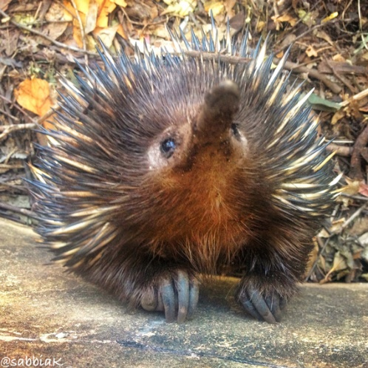
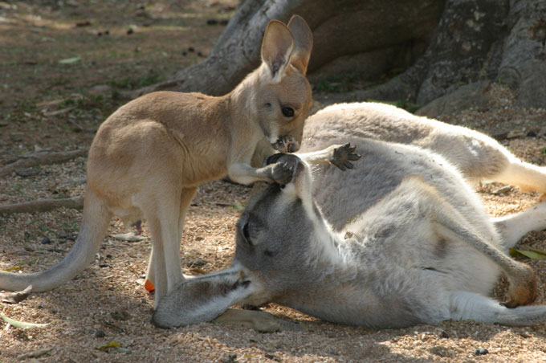
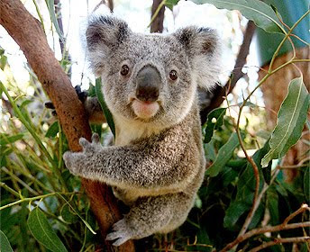
SNAP RANGER
Purpose:
Promote Appreciation of Australia’s native wildlife on the Gold Coast
Provide Education about Australian wildlife
Promote Conservation of Australian wildlife
Notes:
SCENE 1: Presentation of the App
Images/films from gold coast – Australia Geographic
Audio: The SNAP RANGER emerged from the uniqueness nature and wildlife of the Gold Coast City and importance of promote preservation and wildlife care throughout the community.

Slide 3
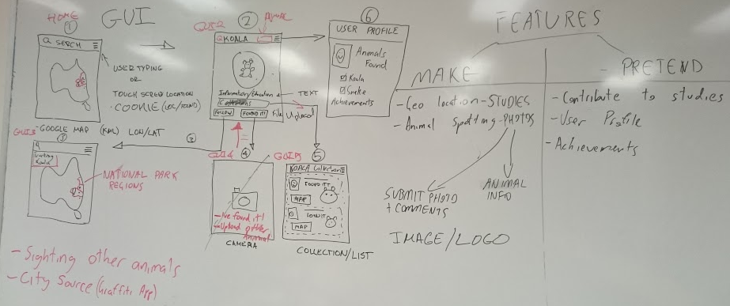
SNAP RANGER

Slide 4
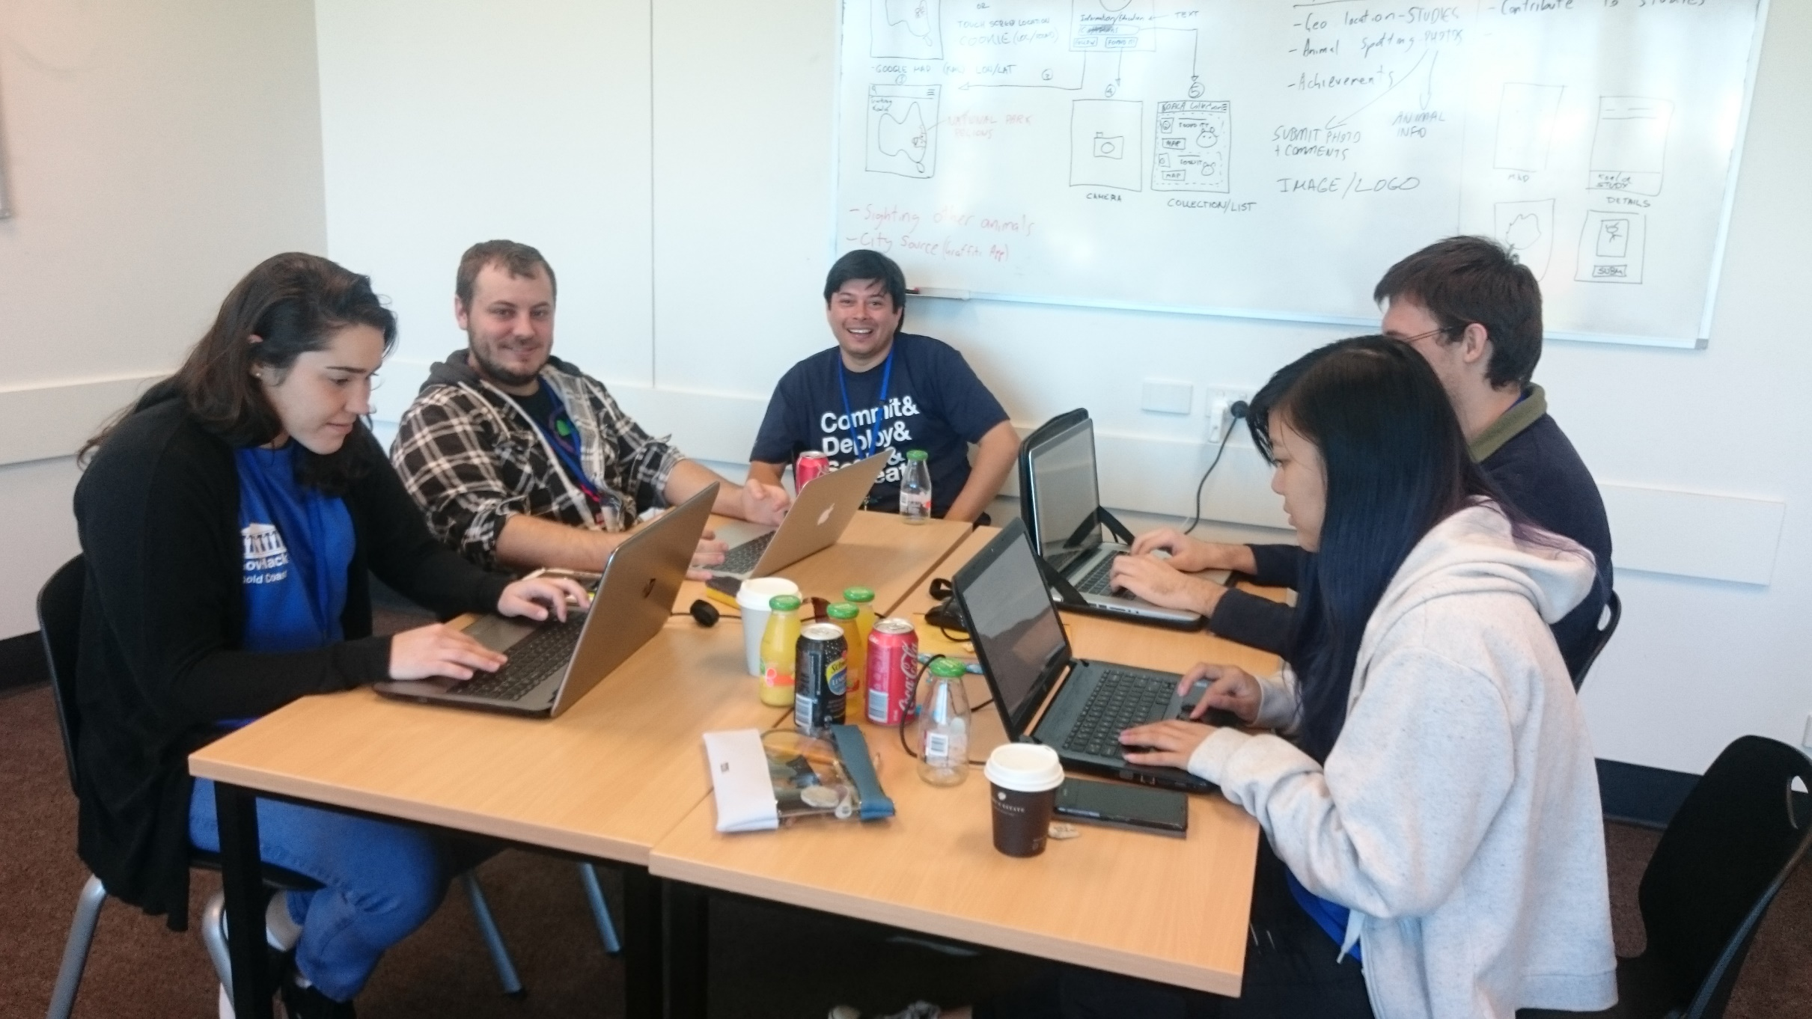
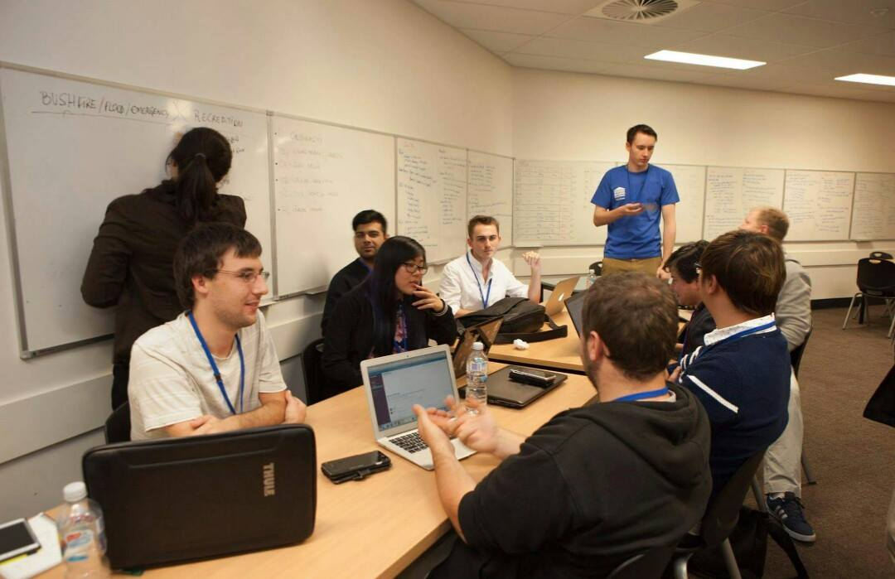
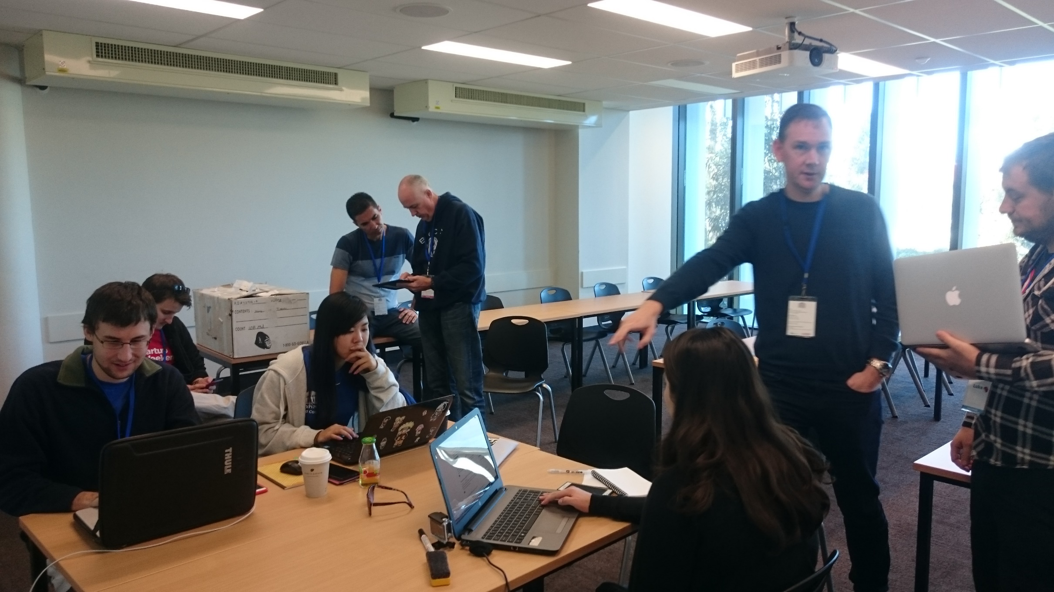
SNAP RANGER

Slide 5
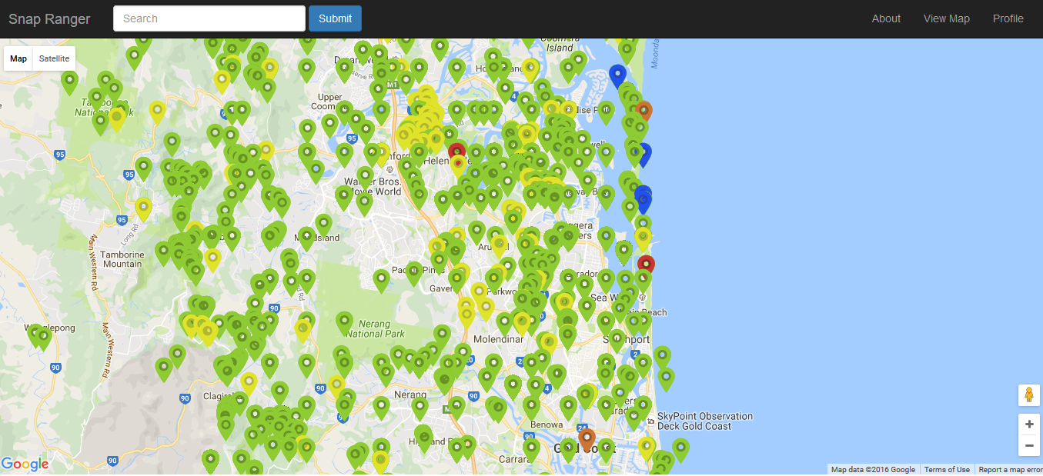
SNAP RANGER

Slide 6
SNAP RANGER
Notes:
SCENE 2: Technical Description of the app
Who: Sebastian
Which database was used
Which languages
Additional relevant technical issues

Slide 7


SNAP RANGER
Database used:
Queensland Government Database
Threats to species and prevention actions:
Conservation status of Queensland Wildlife – Species – Data
Gold Coast City Council Database
Animal Location and basic information:
Nature Conservation Strategy Fauna on the Gold Coast
Notes:
SCENE 3: Usage
Screenshots from the APP (pages?)
Who: Luke?
5 pages
1) MAP
2) INFORMATION
3) TRACKING MAP
4) CAMERA
5) COLLECTION

Slide 8
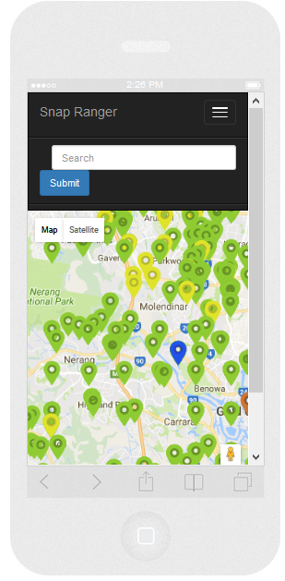
SNAP RANGER
Provides a service for:
Schools
Local Community
Tourists
Future Conservation Actions
Notes:
SCENE 2: Technical Description of the app
Who: Sebastian
Which database was used
Which languages
Additional relevant technical issues

Slide 9
SNAP RANGER
‘Problem Solving’ Government Advantages:
Alignment with Australia’s Biodiversity Conservation Strategy (2010-2030)
“Engaging all Australians through mainstreaming biodiversity finding ways to get more Australians to participate in biodiversity conservation and getting measurable results through improving and sharing knowledge.” – Priorities 1 and 3
Alignment with Gold Coast Nature Conservation Strategy (2009-2019)
“conserving the city’s biodiversity and natural assets through Council’s overarching and strong commitment to protecting, managing and restoring a diverse, connected and viable conservation network” – Strategic Objective
Facilitate the engagement of the community with Environmental and Natural Resources Science data

Slide 10
SNAP RANGER
Other Benefits:
Engage, Educate and Inspire Community
Engage, Educate and Inspire Visitors
Using collected research data (in depth and across institutions) – (Future Improvements)
Inspire Discoverability of the Gold Coast region for users
Promotion of healthy lifestyle using outside activities and nature interaction
High potential of implementation

Slide 11
Empower Ranger Team
Luke Thorpe
Sebastian Schimdt
Steffi Tan
Jack Chiang
Jonathan Romero
Rubiana Cury
Alan Monardes

Slide 12



Acknowledgements
Gold Coast GovHack 2016 Amazing Crew and Mentors!!
and
GovHack 2016 Sponsors:

